Slide 1
QMiner
Blaž Fortuna, Jan Rupnik

Slide 2
Overview
QMiner is a data analytics platform for processing of large-scale real-time streams containing structured and unstructured data
Connecting storage, indexing and analytics: direct conversions from storage to feature vectors and back
Native support for unstructured (text, graphs) and streaming (time series, text streams) data
Fast prototyping from data, to models to web-service APIs
Open-sourced under AGPL
http://qminer.ijs.si/
https://github.com/qminer/qminer

Slide 3
Architecture
QMiner Server
Analytics
Feature Extractors
(Stream) Aggregates
JavaScript API
Index
Storage

Slide 4
Storage and Index layer
Simple storage system
Requires predefined schema
Implemented search index:
Inverted Index for indexing discrete values and text
Geospatial Index for indexing geographic locations
B-tree for indexing linearly ordered data types (to be included)
Local Proximity Hashing used to answer nearest neighbour queries on high-dimensional data such as sparse vectors (to be included)
NoSQL-like Query language:
MongoDB and Freebase JSon-like query languages

Slide 5
Example schema definition
{
"name": "Movies",
"fields": [
{ "name": "Title", "type": "string" },
{ "name": "Plot", "type": "string", "store" : "cache" },
{ "name": "Year", "type": "int" },
{ "name": "Rating", "type": "float" },
{ "name": "Genres", "type": "string_v", "codebook" : true }
],
"joins": [
{ "name": "Actor", "type": "index", "store": "People", "inverse" : "ActedIn" },
{ "name": "Director", "type": "field", "store": "People", "inverse" : "Directed" }
],
"keys": [
{ "field": "Title", "type": "value" },
{ "field": "Title", "name": "TitleTxt", "type": "text", "vocabulary" : "voc_01" },
{ "field": "Plot", "type": "text", "vocabulary" : "voc_01" },
{ "field": "Genres", "type": "value" }
]
}
https://github.com/qminer/qminer/wiki/Store-definition

Slide 6
Query Language
Selectors over indexed keys
{ $from: "Movies", $or: [{ Title: "lost" }, { Plot: "lost" }]}
Probabilistic joins
{ $join: { $name: "Actor",
$query: { $from: "Movies", Genres: "Horror"}}}
Aggregates over results
{ name: "Plot", type: "keywords", field: "Plot" }
{ name: "Rating", type: "histogram", field: "Rating" }
{ name: "Genres", type: "count", field: "Genres" }
https://github.com/qminer/qminer/wiki/Query-Language

Slide 7
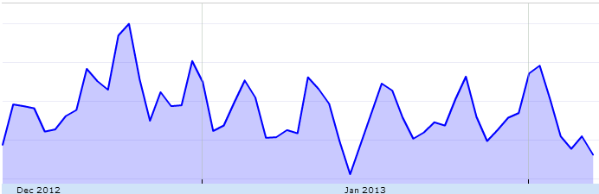
Example: Twitter search “beer”
drinking, day, tonight, time, good, night, lol, mate, lovely, haha, christmas, work, home, ll, nice, yeah, food, back, today, feel, curry, wine, football, pint, opener, watch
beer, perfect, cheers, yolo, merrychristmas, fb, christmas, photo, camrgb, bliss, coyi, decent, lad, nightclubfails, coyg, superbowl, suffolk, buzzing, curry, vodka, becauseican, hangoverinthemorning

Slide 8
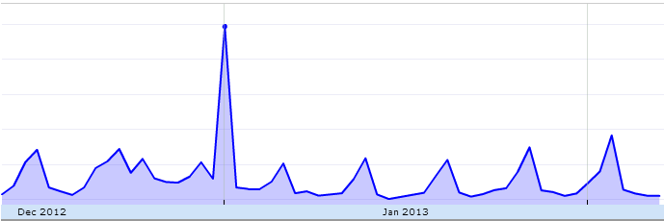
Example: Twitter search “hangover”
cure, day, feeling, drink, night, good, work, year, today, morning, haha, worst, love, tomorrow, time, christmas, bad, wake, food, bed, drunk
hangover, winning, happynewyear, perfect, food, nye, notfair, toooldforthisshit, dedication, sick, fucked, badtimes, backtobed, goodnight, yay, ouch, beer, fresh, dying, bed, death

Slide 9
Aggregators
Batch mode
Work on static record sets and produce one-time result
Accessible via query language
Streaming mode (Stream Aggregators)
Updated in real-time as new data added to storage layer
Can be composed into pipelines
Integrated stream aggregators:
Time series indicators (MA, EMA, double EMA, …)
Resampling of input stream
Merging of two or more input streams
Delay
…
Store
Tick
MA
EMA
dEMA
https://github.com/qminer/qminer/wiki/Stream-Aggregates

Slide 10
Feature Extractors
Mappings from data records to (sparse) feature vectors
Defined using declarative language
Work on stream data
Built-in functionality for extraction of features:
Numeric, Categorical, Multinomial, Bag-of-Words, Join, Pair
Include all Glib text processing machinery (stemmer, stop-words, hashing)
https://github.com/qminer/qminer/wiki/Feature-Extractors

Slide 11
Example
Feature extractors:
{ type: "text", source: "Movies", field: "Title" }
{ type: "text", source: "Movies", field: "Plot" }
{ type: "multinomial", source: "Movies", field: "Genres" }
{ type: "join", source: { store: "Movies", join: "Actor" }}
{
"Title": "Every Day",
"Plot": "This day really isn't all that different than...",
"Year": 2010,
"Rating": 5.6,
"Genres": [ "Comedy", "Drama" ],
"Director": {"Name": "Levine Richard (III)", "Gender": "Male" },
"Actor": [ { "Name": "Beetem Chris", "Gender": "Male" }, ... ]
}
Title
Body
Genres
Actors

Slide 12
Analytics – Linear Algebra
Wrapped parts of C++ linalg library. Most functions can benefit from high performance libraries such as intel MKL or open blas.
Computationally light parts and gluing scripts can be implemented directly in JS (examples: conjugate gradient, number nonzero elements in sparse matrices)
Five main classes: la (linear algebra), full vectors and matrices and dense vectors and matrices.
Supported functionality enables constructing elements in various ways, computing linear combinations, multiplication, transposition, norm computations,...
We have also exposed some important building blocks: large scale SVD (dense, sparse), solving linear systems (LU decomposition for dense systems, conjugate gradient for symmetric positive definite matrices)

Slide 13
Analytics – Learning
Works on top of extracted features
Implemented Techniques:
Classification:
SVM (batch)
Perceptron (updates)
Hoeffding trees (updates)
Active learning (uncertainty sampling + SVM)
Regression:
SVMR (batch)
Ridge regression (batch)
Ridge regression (updates)
Clustering:
k-means (batch)
Lloyd algorithm (updates),

Slide 14
JavaScript API
Major functionality exposed via JavaScript API
Using Google V8 JavaScript engine
Current status: More then 20 objects and 300 functions
Exposed APIs
Data layer – storage, indexing, retrieval
Linear algebra – full and sparse vector and matrix, matrix operations
Learning algorithms – supervised, unsupervised, active learning
Stream aggregates – definition, access to real-time values
Input/Output – file system, web services (easy RESTful APIs)
Documentation:
https://github.com/qminer/qminer/wiki/JavaScript

Slide 15
Installation
Installation:
git clone https://github.com/qminer/qminer.git
cd qminer
make lib
make
./test/javascript/test.sh
Main build results (qminer/build):
qm - QMiner executable
*.js – QMiner JavaScript support functions
gui/ - administration GUI
lib/ - available JavaScript libraries (can be included using 'require')
Environment variable:
QMINER_HOME=($QMINER)/build

Slide 16
Quick start
Configure:
qm config -port=8080
Initialize storage according to provided schema:
qm create -def=schema.def
Start QMiner:
qm start
qm start –noserver
qm start –rdonly
Stop Qminer
qm stop

Slide 17
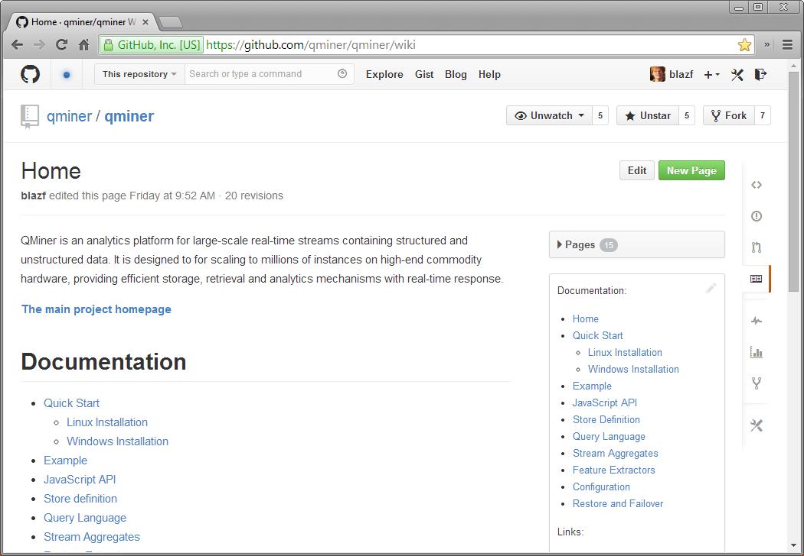
Documentation
Home
Quick Start
Linux Installation
Windows Installation
Example
JavaScript API
Store Definition
Query Language
Stream Aggregates
Feature Extractors
Configuration
Restore and Failover

Slide 18
Example – Movies.js
http://htmlpreview.github.io/?https://raw.github.com/qminer/qminer/master/docjs/movies.html
// Import analytics module
var analytics = require("analytics.js");
// Loading in the dataset.
qm.load.jsonFile(Movies, "./sandbox/movies/movies.json");
// Declare the features we will use to build genre classification models
var genreFeatures = [
{ type: "text", source: "Movies", field: "Title" },
{ type: "text", source: "Movies", field: "Plot" },
{ type: "join", source: { store: "Movies", join: "Actor" } },
{ type: "join", source: { store: "Movies", join: "Director"} }
];
// Create a model for the Genres field, using all the movies as training set.
var genreModel = analytics.newBatchModel(Movies.recs,
genreFeatures, Movies.field("Genres"));
// Predict genres of a new movie
var newMovie = qm.store("Movies").newRec({...});
var result = genreModel.predict(newMovie);

Slide 19
Example – TimeSeries.js
http://htmlpreview.github.io/?https://raw.github.com/qminer/qminer/master/docjs/timeseries.html
Time | Value
2012-01-08T22:00:18.623 | 1.26957
2012-01-08T22:00:18.950 | 1.26952
2012-01-08T22:00:19.310 | 1.26953
… | …
Raw store
Resampler
Time | Value
2012-01-08T22:00:18 | 1.26957
2012-01-08T22:00:28 | 1.26947
2012-01-08T22:00:38 | 1.26956
… | …
EMA1m
EMA10m
Delay
Resampled store
Tick
EMA1m
0.00000
0.00000
0.19490
…
EMA10m
0.000000
0.000000
0.020984
…
EMA 1m
EMA 10m

Slide 20
Example – TimeSeries.js
http://htmlpreview.github.io/?https://raw.github.com/qminer/qminer/master/docjs/timeseries.html
// Initialize resamper from Raw to Resampled store. This results in
// in an equaly spaced time series with 10 second interval.
Raw.addStreamAggr({ name: "Resample10second", type: "resampler",
outStore: "Resampled", timestamp: "Time",
fields: [ { name: "Value", interpolator: "previous" } ],
createStore: false, interval: 10 * 1000
});
// Initialize stream aggregates on Resampled store for computing
// 1 minute and 10 minute exponential moving averages.
Resampled.addStreamAggr({ name: "tick", type: "timeSeriesTick",
timestamp: "Time", value: "Value" });
Resampled.addStreamAggr({ name: "ema1m", type: "ema",
inAggr: "tick", emaType: "previous", interval: 60000, initWindow: 10000 });
Resampled.addStreamAggr({ name: "ema10m", type: "ema",
inAggr: "tick", emaType: "previous", interval: 600000, initWindow: 10000
});
// Buffer for keeping track of the record from 1 minute ago
Resampled.addStreamAggr({ name: "delay", type: "recordBuffer", size: 6});

Slide 21
Example – TimeSeries.js
http://htmlpreview.github.io/?https://raw.github.com/qminer/qminer/master/docjs/timeseries.html
// Declare features from the resampled timeseries
var ftrSpace = analytics.newFeatureSpace([
{ type: "numeric", source: "Resampled", field: "Value" },
{ type: "numeric", source: "Resampled", field: "Ema1" },
{ type: "numeric", source: "Resampled", field: "Ema2" },
{ type: "multinomial", source: "Resampled", field: "Time", datetime: true }
]);
// Initialize linear regression model.
var linreg = analytics.newRecLinReg({ dim: ftrSpace.dim, forgetFact: 0.9999 });
// We register a trigger to Resampled store
Resampled.addTrigger({ onAdd: function (val) {
// Get the latest value for EMAs
val.Ema1 = Resampled.getStreamAggr("ema1m").EMA;
val.Ema2 = Resampled.getStreamAggr("ema10m").EMA;
// Get the id of the record from a minute ago.
var trainRecId = Resampled.getStreamAggr("delay").last;
// Update the model, once we have at leats 1 minute worth of data
linreg.learn(ftrSpace.ftrVec(Resampled[trainRecId]), val.Value);
}
});

Slide 22
Example – linalg.js - CG
la.conjgrad = function (A, b, x) {
var r = b.minus(A.multiply(x));
var p = la.newVec(r); //clone
var rsold = r.inner(r);
for (var i = 0; i < 2*x.length; i++) {
var Ap = A.multiply(p);
var alpha = rsold / Ap.inner(p);
x = x.plus(p.multiply(alpha));
r = r.minus(Ap.multiply(alpha));
var rsnew = r.inner(r);
console.say("resid = " + rsnew);
if (Math.sqrt(rsnew) < 1e-6) {
break;
}
p = r.plus(p.multiply(rsnew/rsold));
rsold = rsnew;
}
return x;
}

Slide 23
Example – Twitter.js – AL
http://htmlpreview.github.io/?https://raw.github.com/qminer/qminer/master/docjs/twitter.html
// Load tweets from a file (toy example)
var tweetsFile = "./sandbox/twitter/toytweets.txt";
var Tweets = qm.store("Tweets");
qm.load.jsonFile(Tweets, tweetsFile);
// Select all tweets
var recSet = Tweets.recs;
// Active learning settings: start svm when 2 positive and 2 negative examples are provided
var nPos = 2; var nNeg = 2; //active learning query mode
// Initial query for "relevant" documents
var relevantQuery = "nice bad";
// Create feature space
var ftrSpace = analytics.newFeatureSpace([
{ type: "text", source: "Tweets", field: "Text" },
]);
// Builds a new feature space
ftrSpace.updateRecords(recSet);
// Constructs the active learner
var AL = new analytics.activeLearner(ftrSpace, "Text", recSet, nPos, nNeg, relevantQuery);
// Starts the active learner (use the keyword stop to quit)
AL.selectQuestion();
// Save the model
AL.saveSvmModel(fs.openWrite('./sandbox/twitter/svmFilter.bin'));

Slide 24
Example – Twitter.js : filtering
http://htmlpreview.github.io/?https://raw.github.com/qminer/qminer/master/docjs/twitter.html
// Load the model from disk
var fin = fs.openRead("./sandbox/twitter/svmFilter.bin");
var svmFilter = analytics.loadSvmModel(fin);
// Filter relevant records: records are dropped if svmFilter predicts a v negative value
recSet.filter(function (rec) { return svmFilter.predict(ftrSpace.ftrSpVec(rec)) > 0; });
// Filter the record set of by time
// Clone the rec set two times
var recSet1 = recSet.clone();
var recSet2 = recSet.clone();
// Set the cutoff date
var tm = time.parse("2011-08-01T00:05:06");
// Get a record set with tweets older than tm
recSet1.filter(function (rec) { return rec.Date.timestamp < tm.timestamp })
// Get a record set with tweets newer than tm
recSet2.filter(function (rec) { return rec.Date.timestamp > tm.timestamp })

Slide 25
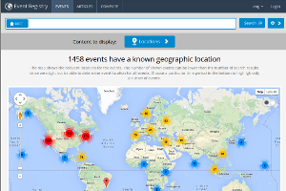
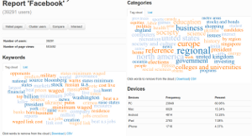

Usage
Applications:
Event registry
Event Type classification
News recommendation
Web audience segmentation
Projects:
XLike
Sophocles
SMER+
Mobis
ProaSense
Symphony

Slide 26
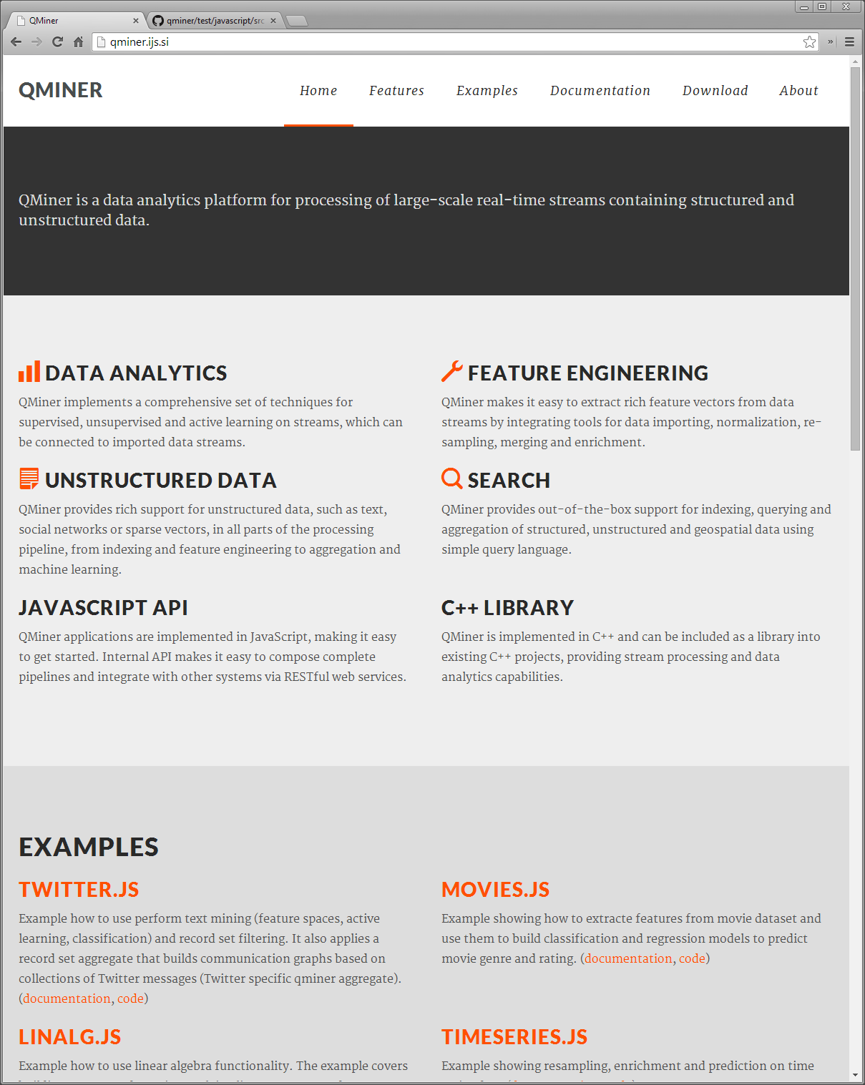
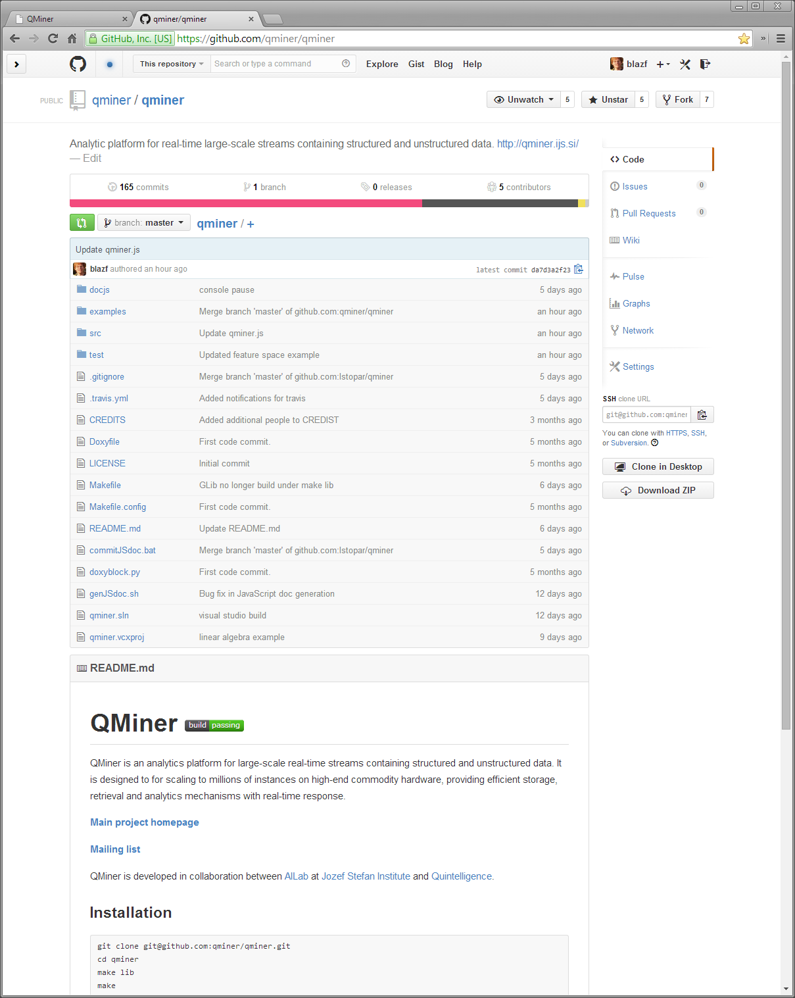
Thank you!
http://qminer.ijs.si/
https://github.com/qminer/qminer

Slide 27
Raw store
resample
sr
Resampler
add rec
s3
s0
Resampled store
connect
Delay
Tick
smooth
enrich
smooth
update regression
update regression
s4
s3
EMA 1m
EnrichmentRegression
s2
EMA 10m

